Slide 1
Policy Based Methods

Slide 2
Objectives
Parameterized Policy
Stochastic policies
Too much information
Stability
Optimize the policy directly
REINFORCE algorithm
Vanilla Policy Gradient (VPG)
More advanced approaches
The RL zoo

Slide 3


Parameterized Policy (1)
Until now, almost all the methods have been value-based methods
they learned the values of actions
then selected actions based on their estimated action values
their policies don’t exist without the value function estimates
Now, we consider policy-based methods
learn directly a parameterized policy
to select actions without consulting a value function
Objective: maximize performance of the parameterized policy, based on the gradient of some scalar performance measure with respect to the policy parameter:

Slide 4
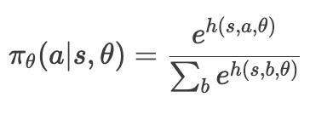

Parameterized Policy (2)
The policy can be parameterized in any way, as long as it is differentiable with respect to its parameters
In practice, to ensure exploration, we generally require that the policy never becomes deterministic.
as an example, we can parameterize as a softmax distribution
where h is the preference function for actions in states, which can be can be parameterized arbitrarily (might be a neural network)
exploration can be embedded in the learned function
As performance measure, it is natural to define it as the expected total discounted reward from the initial state

Slide 5
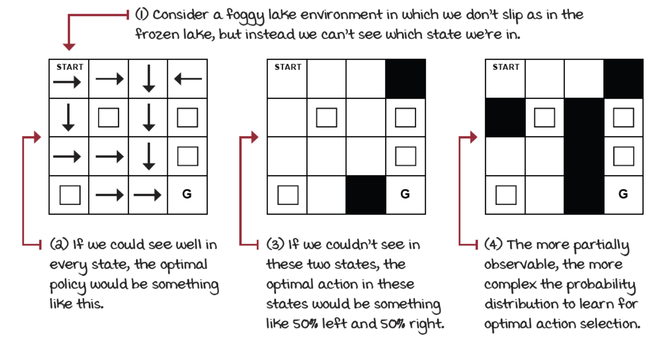
Stochastic policies
We can now learn stochastic policies, with better performance under partially observable environments
the agent is less dependent on the Markov assumption
For example: if agent can’t distinguish some states from their observations, the best strategy is often to act randomly with specific probabilities

Slide 6
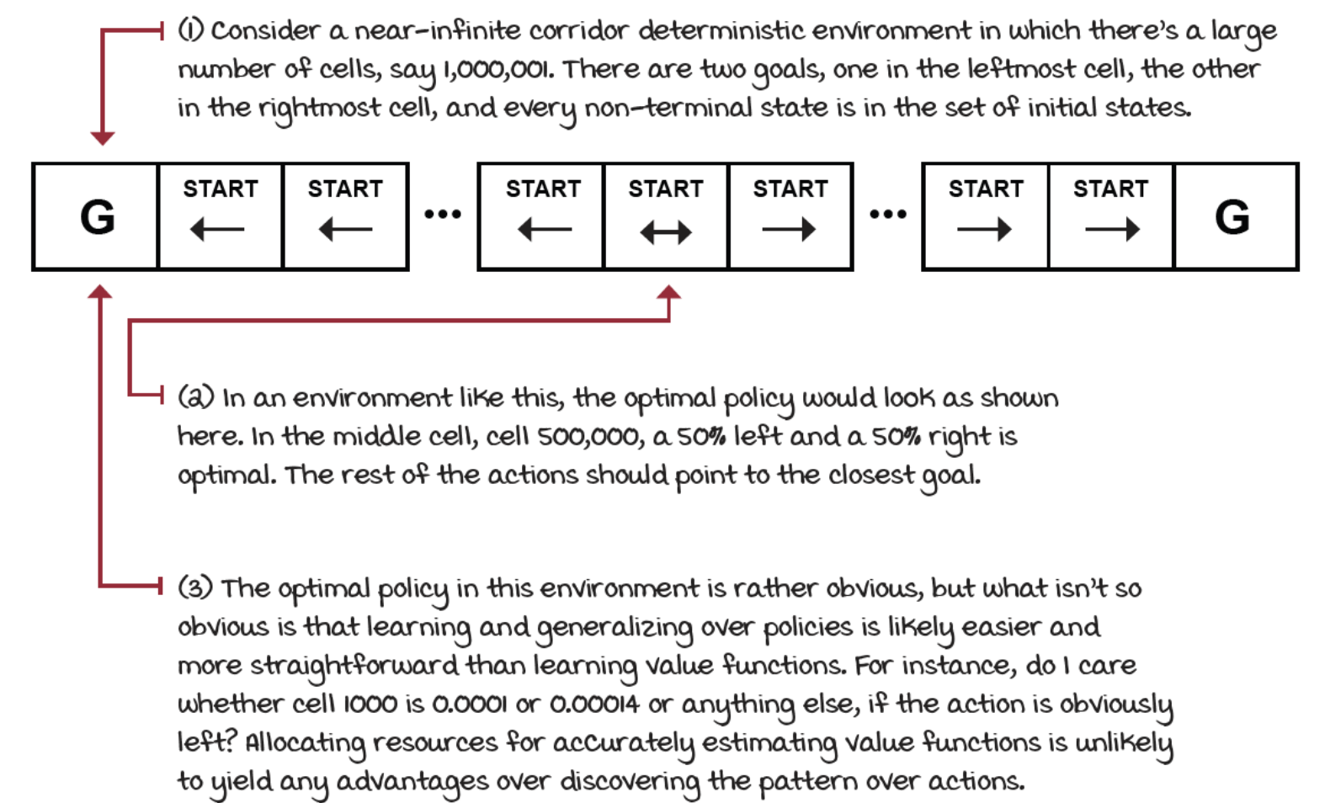
Too much information
Sometimes value functions are too much informative

Slide 7
Stability
Value-based methods are prone to oscillations and even divergence
tiny changes in value-function space may imply significant changes in action space
a significant difference in actions can create entirely unusual new trajectories,
and therefore create instabilities.
Policy-based methods follow the gradient with respect to stochastic policies, which only progressively and smoothly changes the actions.
better convergence properties

Slide 8


Optimize the policy directly (1)
We want to find the gradient with respect to the performance metric defined before:
Let’s use tau ad a variable representing a trajectory
We can define the return of a trajectory and its probability
Using this notation, we can rewrite the objective as:

Slide 9

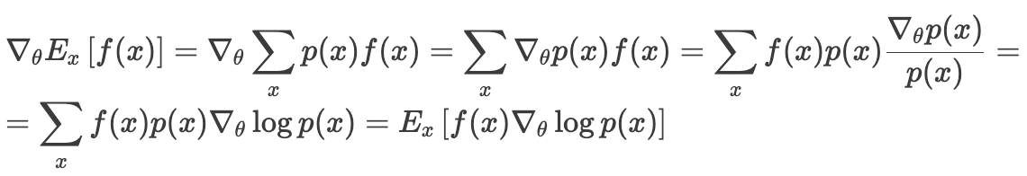

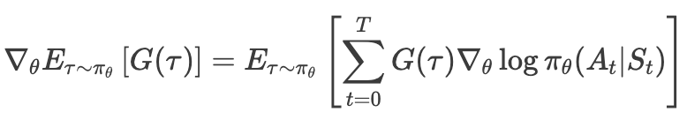
Optimize the policy directly (2)
Now, we can apply the score function gradient estimator using a trick called likelihood ratio
idea: rewrite the gradient of the expectation as the expectation of the gradient
derivation:
Use the result in our case:
substituting the probability expression, turning the logarithm of a product in the sum of the logarithms, and differentiating with respect to theta:

Slide 10
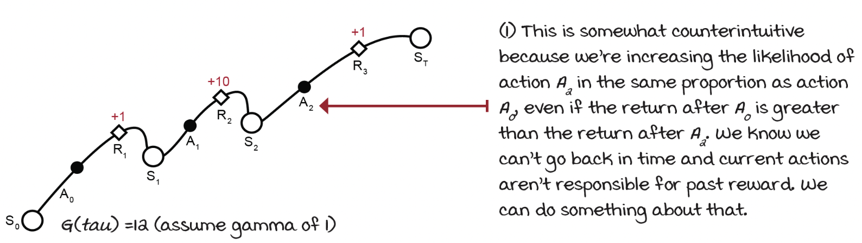
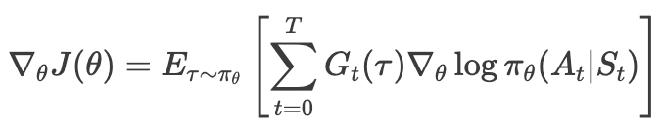
Optimize the policy directly (3)
We can compute the gradient without knowing anything about the environment transition function:
collect a full trajectory tau
calculate the full discounted return G(tau)
use that to weight the log probabilities of every action taken in the trajectory
However, it is better to use only the causal reward
For each step, we calculate the return just from that step:

Slide 11
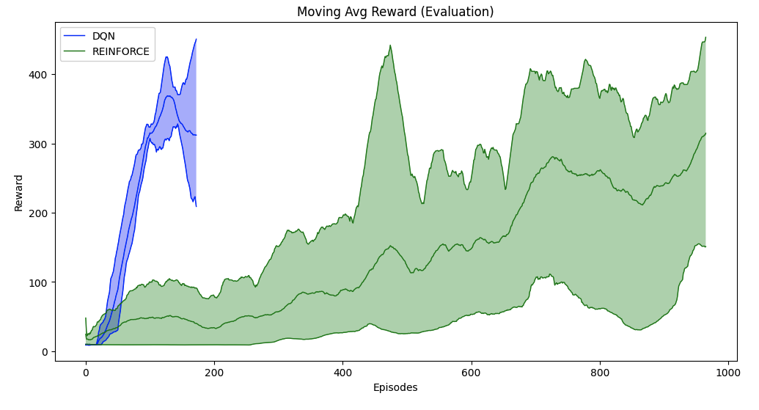
REINFORCE algorithm (1)
Implements the idea estimating the gradient using the full Monte Carlo returns using a neural network to represent the policy
See reinforce.ipynb notebook

Slide 12
REINFORCE algorithm (2)
The algorithm works well in simple problems, and it has convergence guarantees
But because it uses the full Monte Carlo returns for calculating the gradient, its variance is a problem
accumulation of random events along a trajectory and the randomness of the action selection is compounded inside the return
It is too inefficient to be a practical algorithm

Slide 13


Vanilla Policy Gradient (VPG) (1)
Use partial returns instead of the full return
Action log probabilities change in the proportion of the return
if we receive a significant positive (negative) return, the probabilities of the actions that led to that return are increased (decreased) by a large margin
imagine an environment (such as the cartpole) in which all rewards and returns are positive: in order to accurately separate okay actions from the best actions, we need a lot of data
It would be handy if we could use something that allows us to differentiate the values of actions in the same state
action-advantage function
An estimate is the return minus the estimated expected return

Slide 14
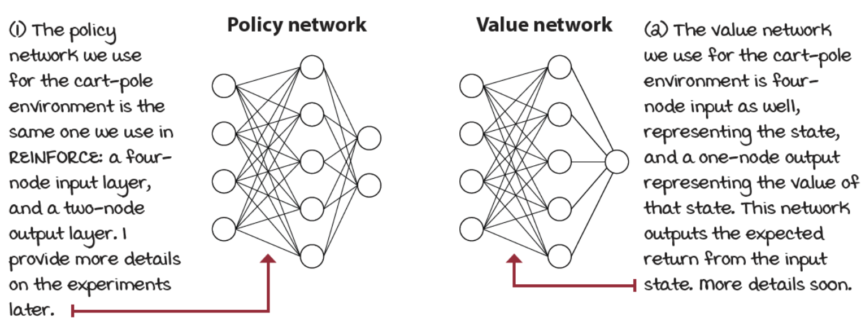
Vanilla Policy Gradient (VPG) (2)
Using the advantage somewhat canters scores around zero
better-than-average actions have a positive score (increase the probabilities)
worse-than-average, a negative score (decreases the probabilities)
We need two neural networks, one for learning the policy, the other for learning a state-value function:

Slide 15
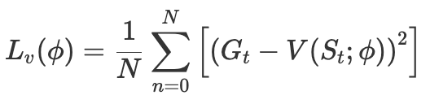
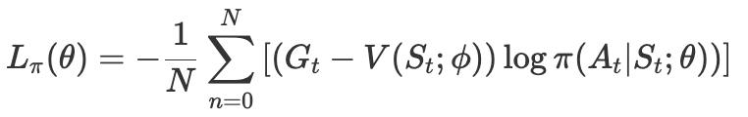
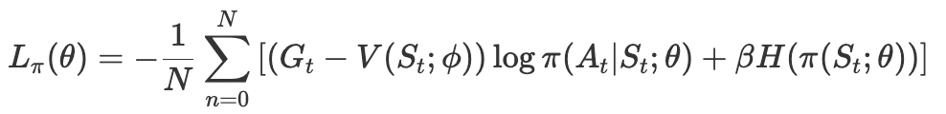
Vanilla Policy Gradient (VPG) (3)
The loss for the value function is simple, the mean squared Monte Carlo error:
The loss of the policy is the estimated advantage weighted by the log probability of the action taken
Another improvement is to add an entropy term to to the loss function to encourage exploration
a uniform distribution has high entropy
two samples, both with a 50% chance, have highest entropy
conversely, two samples, one with 100% chance, then the entropy is the lowest
See vpg.ipynb notebook

Slide 16
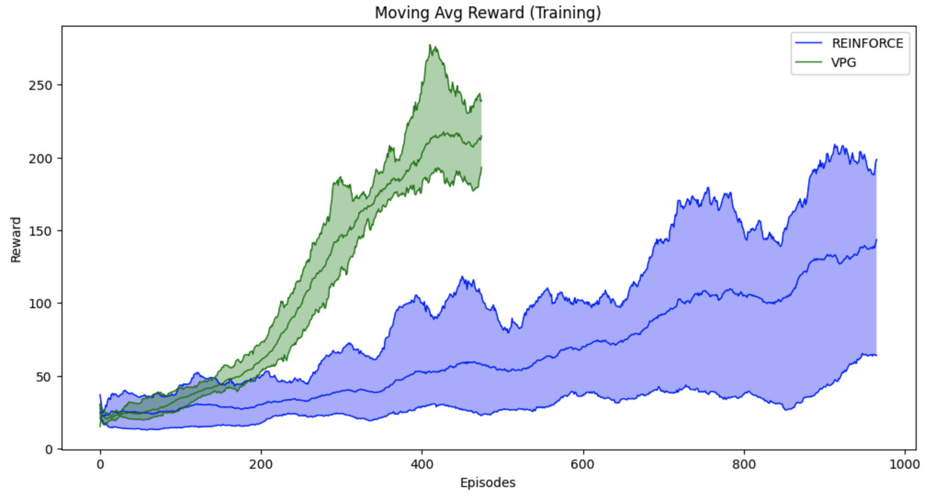
Vanilla Policy Gradient (VPG) (4)

Slide 17
More advanced approaches
Actor-Critic methods ​
methods that learn both policies and value functions​
the policy (selects actions) can be seen as an actor
the value function (evaluates policies) can be seen as a critic​
often perform better than value-based or policy-based methods alone​
Deep Deterministic Policy Gradient (DDPG),
Twin-Delayed DDPG (TD3),
Doft Actor-Critic (SAC),
Proxima Policy Optimization (PPO)

Slide 18
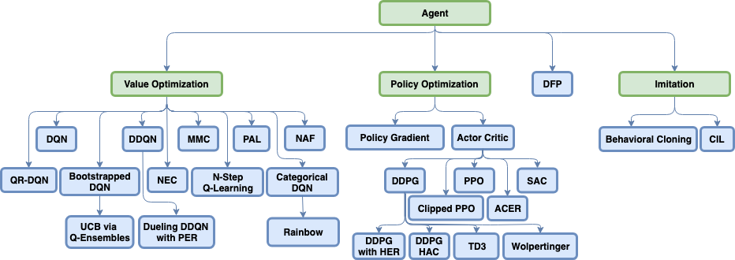
The RL zoo

